Slide 1
Memory Management – Continued
More on Linking, Loading, Paging

Slide 2
Review of last class
MMU : Hardware features for MM
OS: Sets up MMU for a process, then schedules process
Compiler : Generates object code for a particular OS + MMU architecture
MMU: Detects memory violations and raises interrupt --> Effectively passing control to OS

Slide 3
Review of last class
Different types of MMUs
  No translation (no MMU)!
  Base + limit (also called relocation + offset) scheme
    Leads to what type of OS ?
  Multiple base + limit scheme --> segmentation
    Offers which benefits?
    Problem: fragmentation
  Paging – logical division of the physical memory into equal sized pages, in memory page table + PTBR in hardware, OS’s job and compiler’s job in this case

Slide 4
More on Linking and Loading
Static Linking: All object code combined at link time and a big object code file is created
Static Loading: All the code is loaded in memory at the time of exec()
Problem: Big executable files, need to load functions even if they do not execute
Solution: Dynamic Linking and Dynamic Loading

Slide 5
Dynamic Linking
Linker is normally invoked as a part of compilation process
  Links
    function code to function calls
    references to global variables with “extern” declarations
Dynamic Linker
  Does not combine function code with the object code file
  Instead introduces a “stub” code that is indirect reference to actual code
  At the time of “loading” (or executing!) the program in memory, the “link-loader” (part of OS!) will pick up the relevant code from the library machine code file (e.g. libc.so.6)

Slide 6
Dynamic Linking on Linux
#include <stdio.h>
int main() {
int a, b;
scanf("%d%d", &a, &b);
printf("%d %d\n", a, b);
return 0;
}
Output of objdump -x -D
Disassembly of section .text:
0000000000001189 <main>:
11d4: callq 1080 <printf@plt>
Disassembly of section .plt.got:
0000000000001080 <printf@plt>:
1080: endbr64
1084: bnd jmpq *0x2f3d(%rip) # 3fc8 <printf@GLIBC_2.2.5>
108b: nopl 0x0(%rax,%rax,1)
PLT: Procedure Linkage Table
used to call external procedures/functions whose address is to be resolved by the dynamic linker at run time.

Slide 7
Dynamic Loading
Loader
  Loads the program in memory
  Part of exec() code
  Needs to understand the format of the executable file (e.g. the ELF format)
Dynamic Loading
  Load a part from the ELF file only if needed during execution
  Delayed loading
  Needs a more sophisticated memory management by operating system – to be seen during this series of lectures

Slide 8
Dynamic Linking, Loading
Dynamic linking necessarily demands an advanced type of loader that understands dynamic linking
  Hence called ‘link-loader’
  Static or dynamic loading is still a choice
Question: which of the MMU options will alllow for which type of linking, loading ?

Slide 9
Continous memory management

Slide 10
What is Continous memory management?
Entire process is hosted as one continous chunk in RAM
Memory is typically divided into two partitions
  One for OS and other for processes
  OS most typically located in “high memory” addresses, because interrupt vectors map to that location (Linux, Windows) !

Slide 11

Hardware support needed: base + limit (or relocation + limit)
base/relocation address
Process
In
RAM

Slide 12
Problems faced by OS
Find a continuous chunk for the process being forked
Different processes are of different sizes
  Allocate a size parameter in the PCB
After a process is over – free the memory occupied by it
Maintain a list of free areas, and occupied areas
  Can be done using an array, or linked list

Slide 13
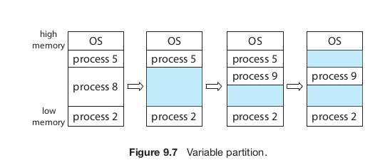
Variable partition scheme

Slide 14
Problem: how to find a “hole” to fit in new process
Suppose there are 3 free memory regions of sizes 30k, 40k, 20k
The newly created process (during fork() + exec()) needs 15k
Which region to allocate to it ?

Slide 15
Strategies for finding a free chunk
6k, 17k, 16k, 40k holes . Need 15k.
Best fit: Find the smallest hole, larger than process. Ans: 16k
Worst fit: Find the largest hole. Ans: 40k
First fit: Find the “first” hole larger than the process. Ans: 17k

Slide 16
Problem : External fragmentation
Free chunks: 30k, 40k, 20k
The newly created process (during fork() + exec()) needs 50k
Total free memory: 30+40+20 = 90k
  But can’t allocate 50k !

Slide 17
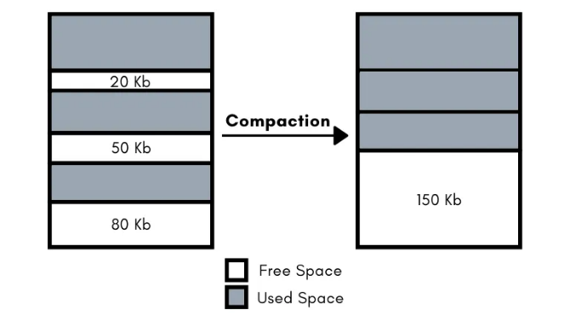
Solution to external fragmentation
Compaction !
OS moves the process chunks in memory to make available continous memory region
  Then it must update the memory management information in PCB (e.g. base of the process) of each process
Time consuming
Possible only if the relocation+limit scheme of MMU is available
P1
P1
P2
P2
P3
P3

Slide 18
Another solution to external fragmentation: Fixed size partitions
Fixed partition scheme
Memory is divided by OS into chunks of equal size: e.g., say, 50k
  If total 1M memory, then 20 such chunks
Allocate one or more chunks to a process, such that the total size is >= the size of the process
  E.g.if request is 50k, allocate 1 chunk
  If request is 40k, still allocate 1 chunk
  If request is 60k, then allocate 2 chunks
Leads to internal fragmentation
  space wasted in the case of 40k or 60k requests above
50K
Kernel
50K
Kernel
50K
Free
50K
P1 (50 KB)
50K
P2 (80 KB)
50K
Unused (20 KB)
50K
Free
50K
P3 (120 KB)
50K
50K
Unused (30 KB)
50K
Free
50K
Free

Slide 19
Fixed partition scheme
OS needs to keep track of
  Which partition is free and which is used by which process
  Free partitions can simply be tracked using a bitmap or a list of numbers
  Each process’s PCB will contain list of partitions allocated to it

Slide 20
Solution to internal fragmentation
Reduce the size of the fixed sized partition
How small then ?
  Smaller partitions mean more overhead for the operating system in allocating deallocating

Slide 21
Paging

Slide 22
An extended version of fixed size partitions
Partition = page
  Process = logically continuous sequence of bytes, divided in ‘page’ sizes
  Memory divided into equally sized page ‘frames’
Important distinction
  Process need not be continous in RAM
  Different page sized chunks of process can go in any page frame
  Page table to map pages into frames

Slide 23

Logical address seen as

Slide 24
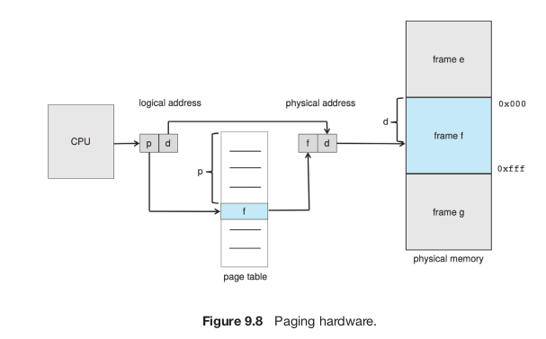
Paging hardware

Slide 25
MMU’s job
To translate a logical address generated by the CPU to a physical address:
1. Extract the page number p and use it as an index into the page table.
(Page table location is stored in a hardware register
Also stored in PCB of the process, so that it can be used to load the hardware register on a context switch)
2. Extract the corresponding frame number f from the page table.
3. Replace the page number p in the logical address with the frame number f .

Slide 26
Job of OS
Allocate a page table for the process, at time of fork()/exec()
  Allocate frames to process
  Fill in page table entries
In PCB of each process, maintain
  Page table location (address)
  List of pages frames allocated to this process
During context switch of the process, load the PTBR using the PCB

Slide 27
Job of OS
Maintain a list of all page frames
  Allocated frames
  Free Frames (called frame table)
  Can be done using simple linked list
  Innovative data structures can also be used to maintain free and allocated frames list (e.g. xv6 code)

Slide 28
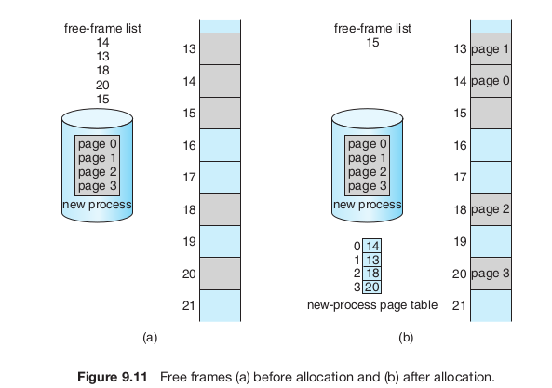

Slide 29
Disadvantage of Paging
Each memory access results in two memory accesses!
  One for page table, and one for the actual memory location !
  Done as part of execution of instruction in hardware (not by OS!)
  Slow down by 50%

Slide 30
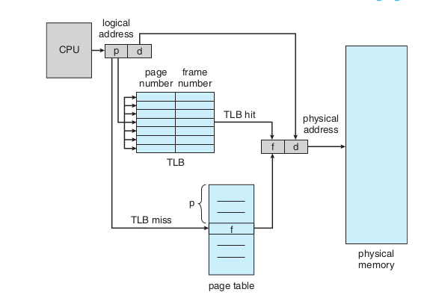
Speeding up paging
Translation Lookaside Buffer (TLB)
Part of CPU hardware
A cache of Page table entries
Searched in parallel for a page number

Slide 31
Speedup due to TLB
Hit ratio
Effective memory access time
  = Hit ratio * 1 memory access time + miss ratio * 2 memory access time
Example: memory access time 10ns, hit ratio = 0.8, then
  effective access time = 0.80 × 10 + 0.20 × 20
  = 12 nanoseconds

Slide 32
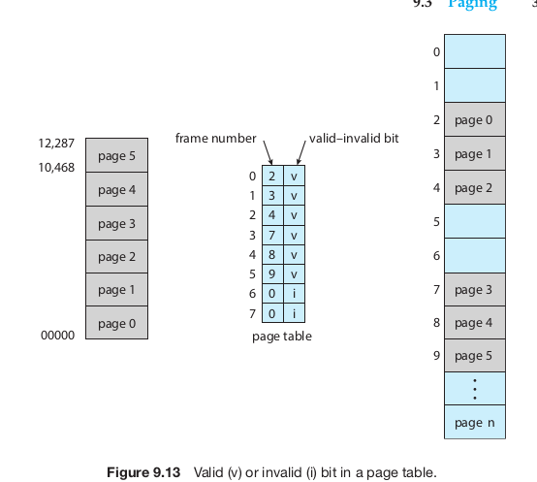
Memory protection with paging

Slide 33

X86 PDE and PTE

Slide 34
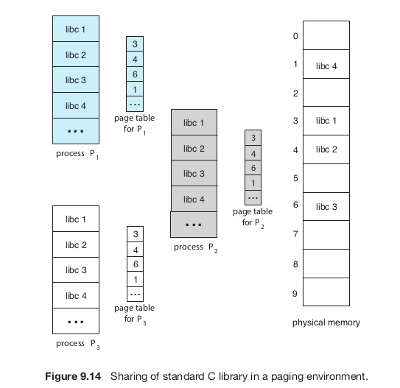
Shared pages (e.g. library) with paging

Slide 35
Paging: problem of large PT
64 bit address
Suppose 20 bit offset
  That means 2^20 = 1 MB pages
  44 bit page number: 2^44 that is trillion sized page table!
  Can’t have that big continuous page table!

Slide 36
Paging: problem of large PT
32 bit address
Suppose 12 bit offset
  That means 2^12 = 4 KB pages
  20 bit page number: 2^20 that is a million entries
  Can’t always have that big continuous page table as well, for each process!

Slide 37
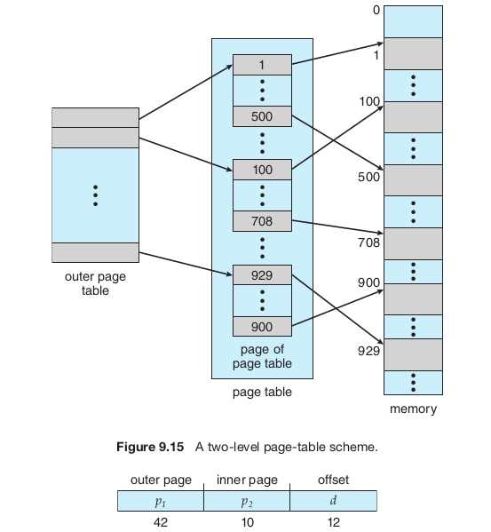
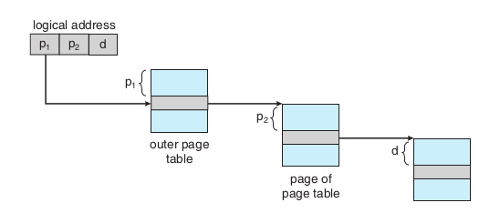
Hierarchical paging

Slide 38

More hierarchy

Slide 39
Problems with hierarchical paging
More number of memory accesses with each level !
  Too slow !
OS data structures also needed in that proportion

Slide 40
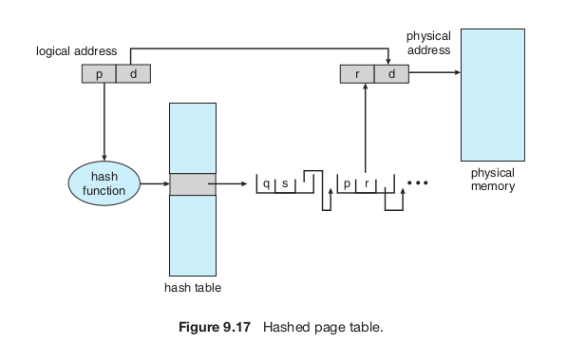
Hashed page table

Slide 41
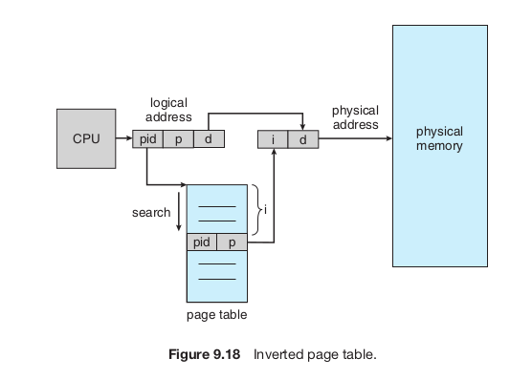
Inverted page table
Normal page table – one per process --> Too much memory consumed
Inverted page table : global table – only one
Needs to store PID in the table entry
Examples of systems using inverted page
tables include the 64-bit Ultra SPARC and Power PC
virtual address
consists of a triple:
<process-id, page-number, offset>

Slide 42
Case Study: Oracle SPARC Solaris
64 bit SPARC processor , 64 bit Solaris OS
Uses Hashed page tables
  one for the kernel and one for all user processes.
  Each hash-table entry : base + span (#pages)
    Reduces number of entries required

Slide 43
Case Study: Oracle SPARC Solaris
Cashing levels: TLB (on CPU), TSB(in Memory), Page Tables (in Memory)
  CPU implements a TLB that holds translation table entries ( TTE s) for fast hardware lookups.
  A cache of these TTEs resides in a in-memory translation storage buffer (TSB ), which includes an entry per recently accessed page
  When a virtual address reference occurs, the hardware searches the TLB for a translation.
  If none is found, the hardware walks through the in memory TSB looking for the TTE that corresponds to the virtual address that caused the lookup

Slide 44
Case Study: Oracle SPARC Solaris
  If a match is found in the TSB , the CPU copies the TSB entry into the TLB , and the memory translation completes.
  If no match is found in the TSB , the kernel is interrupted to search the hash table.
  The kernel then creates a TTE from the appropriate hash table and stores it in the TSB for automatic loading into the TLB by the CPU memory-management unit.
  Finally, the interrupt handler returns control to the MMU , which completes the address translation and retrieves the requested byte or word from main memory.

Slide 45
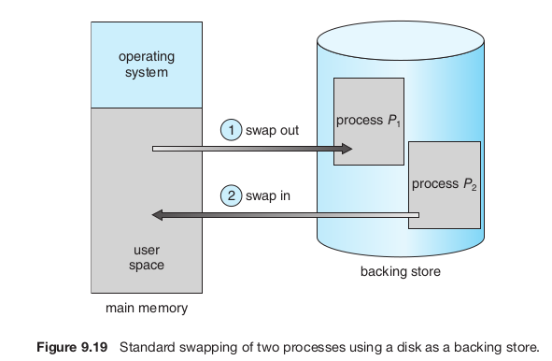
Swapping

Slide 46
Swapping
Standard swapping
  Entire process swapped in or swapped out
  With continous memory management
Swapping with paging
  Some pages are “paged out” and some “paged in”
  Term “paging” refers to paging with swapping now

Slide 47
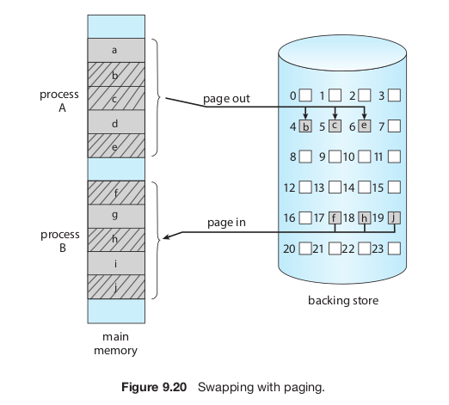

Slide 48
Words of caution about ‘paging’
Not as simple as it sounds when it comes to implementation
  Writing OS code for this is challenging

